Slide 1
Strings

Slide 2
Introduction
Before getting into this topic we should learn somethings which are really needed.So we will learn about Heap and Stack.
Concept of Heap and Stack is very important in this topics.
We are going to learn about String, StringBuffer & StringBuilder class.
2

Slide 3
Heap & Stack
Basically objects are stored in heap and local variables, methods are stored in stack
Heap
Stack
Local variables
Primitive data types
Objects
3

Slide 4
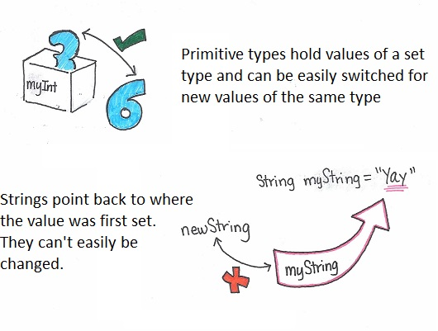
Strings
Strings in Java are different, right from the start. You may have noticed that all of the primitive types are written in all lower case letters. String needs a capital S.
A primitive data type can be changed again and again by reassigning the value, a string can’t be changed once it set.

Slide 5
WAYS OF CREATING STRING IN JAVA
Using String Literal.
Using “new” keyword.

Slide 6
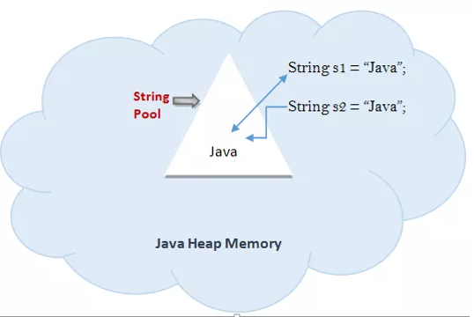
USING STRING LITERAL
To check this, you can compare two String references using == operator to check whether two references are referring to the same String object in the memory.
Example:
String s1 = “Java";
String s2 = “Java";
if(s1 == s2)
System.out.println("s1 and s2 referring to the same object.");

Slide 7
USING “new” KEYWORD
In Java, strings are objects. As with other objects, we can create an instance of a string with the new keyword, as follows:
String s = new String(“Java”);
This line of code creates a new object of class String and assigns it to the reference variable s
So far, String objects seem just like other objects. Now, let's give the string a value:
s = “java";

Slide 8
Strings are immutable objects
String x = "Java";
x.concat(" Rules!");
System.out.println("x = " + x);
Output: x = Java

Slide 9
String is immutable object .
Immutable means once created cannot be changed
The object created as a String is stored in the Constant String Pool.
Every immutable object in Java is thread safe, that implies String is also thread safe .
String cannot be used by two threads simultaneously.
String once assigned cannot be changed.
String a=“Hello World”;
//The above object is stored in constant String pool and its value cannot be modified
a+=“Java Programming”;
//“Hello World" string still exists in string constant pool and its value is not overrided but we lost reference to the “Hello World“ String.
4

Slide 10
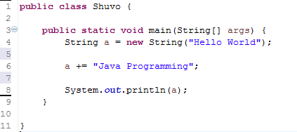
Example with CODE
Heap
Hello World
Heap
Hello World Java Programming
Hello World
5

Slide 11
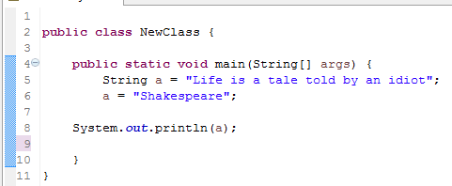
Example with CODE
:String
Life is a tale told by an idiot
It can no longer be accessed
:String
Shakespeare
Life is a tale told by an idiot
6

Slide 12
Important Methods in String Class
char charAt(int index): Returns the character at the specified index
String concat(Sring str): Appends a string to the end of another string
int length(): Returns the length of a specified string
String substring(int beginindex): returns substring for given begin index
String substring(int begin, int end): returns substring for given begin index and end index
String toLowerCase(): returns a string in lowercase
String toUpperCase(): returns a string in uppercase
String trim(): removes beginning and ending spaces of this string
boolean contains(CharSequence s): returns true or false after matching the sequence of char value

Slide 13
static String join(CharSequence delimiter, CharSequence... elements): returns a joined string
boolean equals(Object another): checks the equality of string with the given object
static String equalsIgnoreCase(String another): compares another string. It doesn't check case
boolean isEmpty(): checks if string is empty
String replace(char old, char new): replaces all occurrences of the specified char value
String replace(CharSequence old, CharSequence new): replaces all occurrences of the specified CharSequence
int indexOf(char ch): returns the specified char value index
String[] split(String regex): returns a split string matching regex

Slide 14
Disadvantage of String
String alpha = "";
for(char current = 'a'; current <= 'z'; current++)
alpha += current;
System.out.println(alpha)

Slide 15
String Builder
StringBuilder is same as the StringBuffer , that is it stores the object in heap and it can also be modified .
The main difference between the StringBuffer and StringBuilder is that StringBuilder is also not thread safe.
StringBuilder is fast as it is not thread safe.
StringBuilder object= new StringBuilder("Hello");
object=new StringBuilder("Bye");
//Above statement is right as it modifies the value which is allowed in the StringBuilder.

Slide 16
Advantage of StringBuilder
StringBuilder alpha = new StringBuilder();
for(char current = 'a'; current <= 'z'; current++)
alpha.append(current);
System.out.println(alpha);

Slide 17
String Buffer
StringBuffer is mutable. ( mutable means one can change the value of the object)
The object created through StringBuffer is stored in the heap . StringBuffer has the same methods as the StringBuilder , but each method in StringBuffer is synchronized that is StringBuffer is thread safe .
Due to this it does not allow two threads to simultaneously access the same method . Each method can be accessed by one thread at a time .
But being thread safe has disadvantages too as the performance of the StringBuffer hits due to thread safe property .

Slide 18
String Buffer can be converted to the string by using toString() method
Thus StringBuilder is faster than the StringBuffer when calling the same methods of each class.
StringBuffer value can be changed , it means it can be assigned to the new value .
Example
StringBuffer s = new StringBuffer("Hello World");
s.append(“ Java Programming");
// The Above statement is right in the StringBuffer

Slide 19
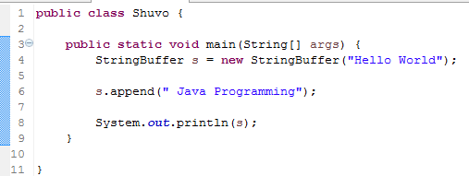
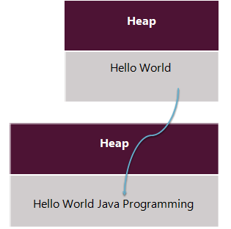
Example

Slide 20
Overview
 | String | StringBuffer | StringBuilder
Storage Area | Constant String Pool | Heap | Heap
Thread Safe | Yes | Yes | No
Modifiable | immutable | mutable | mutable

Slide 21
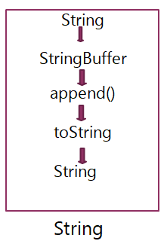
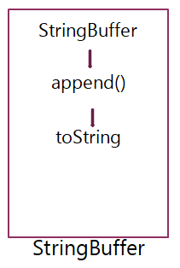
Process of Concatenation of String And StringBuffer
String can be concatenated by using “+” operator or .concat() method.
StringBuffer can be concatenated by using append().
While concatenating StringBuffer is faster than String

Slide 22
Static Initialization Block & Instance Initialization Block
Static Initialization Block | Instance Initialization Block
To define a static initialization block we use the keyword static | No keyword is required to define an instance initialization block.
A static initialization block loads as soon as a class loads and it is not associated with a call to the constructor of a class for object creation. | An instance initialization block is only executed when there is a call to the constructor for creating an object.
Static block can only access static variables and static methods of its class | An instance initialization block can not only access static variables and static methods but also instance variables and instance methods of the class.

Slide 23
There is no automatic call to superclass constructor from the static initialization block. | An instance initialization block always makes an automatic call to superclass constructor by calling super() before executing any other statement in it.
Static block is called just once during the entire execution of the program when the class loads. | Instance initialization block can run many times, whenever there is a call to the constructor of the class

